Slide 1
Outline
Introduction & Background
Challenges
Objectives
Research Methodology
Machine Learning Algorithms
Implementation & Evaluation
Conclusion & Future Work
Questions & Answers

Slide 2
Introduction & Background
Arabic social media users generate a lot of text data (feedback, reviews, and opinion)
There is limited research on automated Arabic sentiment analysis.
This research is important for companies to understand customer feedback and improve their products and services.
Sentiment analysis :
Sentiment analysis is a type of natural language processing that is used to determine the attitude of a text.
It can be used to classify text as positive, negative, or neutral.
It can be used to monitor and analyze social media posts and comments.

Slide 3
Challenges of ASA
The Arabic language is morphologically rich, which makes it difficult to analyze text.
same root word can take on different forms depending on its usage in a sentence
The informal nature of Arabic tweets can make it difficult to identify the sentiment of the text.
The different dialects of Arabic can make it difficult to develop a sentiment analysis model that works for all dialects.
Arabic has diacritics: small marks that are used to indicate the pronunciation of a word

Slide 4
Objectives
The primary aim of the research is to design and implement a sentiment analysis system for Arabic tweets using Python and NLP techniques.
Download Dataset containing Arabic tweets
Preprocess
Apply Feature selection
Train and evaluate ML algorithms
Analyze the results
Deploy and use the best model to classify new tweets.

Slide 5
Research Questions
Can a machine learning algorithm create a model that can predict Arabic sentiment class (Negative, Neutral, or Positive)?
Which classifier emerges as the most accurate and reliable for sentiment analysis?

Slide 6
Sentiment Analysis
Sentiment analysis (SA) is the process of determining the attitude of a text, such as whether it is positive, negative, or neutral.
A has a wide range of applications, including:
Politics: track public opinion on political issues, identify potential threats or issues, and predict elections.
Healthcare: analyze patient reviews of medical treatments, identify potential side effects of drugs, and improve clinical decision-making.
Finance: track stock prices, identify market trends, and make investment decisions.
Shopping websites: monitor customer reviews, identify product defects, and improve customer satisfaction.

Slide 7
Research Methodology
Download Dataset: Acquired dataset of Arabic Tweets from Kaggle website. https://www.kaggle.com/datasets/kirolosatef/nlparabictweets
Preprocess the dataset: Dealing with Missing Values, Feature Selection, Normalization.
Model Training: Apply Machine learning algorithms to the dataset.
Prediction: The generated model predict the polarity of the tweet based on its components. The model can be classify the tweets as positive, negative, or neutral.
Validation: The Generated Models are tested against actual data to determine their accuracy
Implementation: using the best model to predict the sentiment of new Arabic tweets.
Notes:
Download the Dataset from Kaggle
Check for dataset problems, such as having imbalanced classes, or missing values, and solving these issues with best practices. After that apply feature selection, and normalizing on the datasets to ensure optimal and efficient performance of the algorithms to generate a model with high accuracy.
algorithm used: Decision Trees, Random Forests, K-Nearest Neighbours, Support Vector Machines, Logistic Regression, Multinomial Naive Bayes, and Multi-Layer Perceptron.

Slide 8
Types of Machine learning
Notes:
Supervised Learning: Where the algorithm is trained on a pre-defined set of samples (training dataset) with labelled classes or real numbers (Known sentiment class ) We will use the classification method.
Unsupervised Learning: ML is applied on datasets that have samples without a specific latent variable or group. We will not use this learning method
Reinforcement Learning: The ML will learns from trial and error, receiving rewards or penalties for the actions it performs. We will not use this method

Slide 9
Machine learning Algorithm used
The Research used the following algorithms:
Decision Trees
Random Forest
K-Nearest Neighbours
Support Vector Machines
Logistic Regression
Multinomial Naive Bayes
Multi-Layer Perceptron.

Slide 10
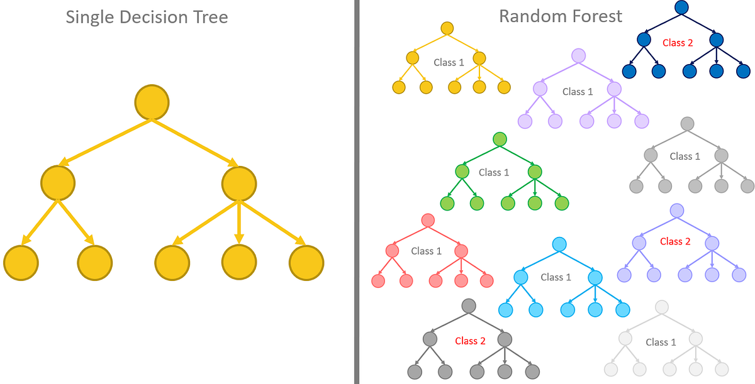
Machine learning Algorithm used cont.
Notes:
Decision Tree: Creates a tree-like model of decisions and their possible consequences.
Random Forest: which is an ensemble learning algorithm that combines multiple decision trees to make predictions.

Slide 11
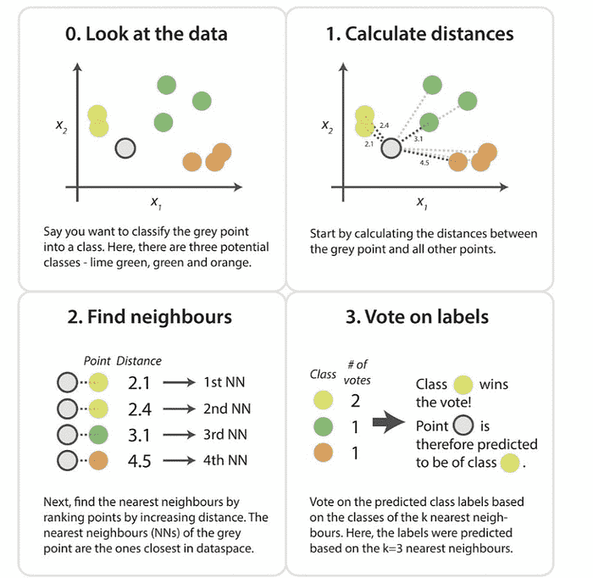
Machine learning Algorithm used cont.
K-Nearest Neighbours
Notes:
K-Nearest Neighbors (KNN): predicts the value of a new data point by finding the k most similar data points in the training set and then averaging the values of the k most similar data points.

Slide 12
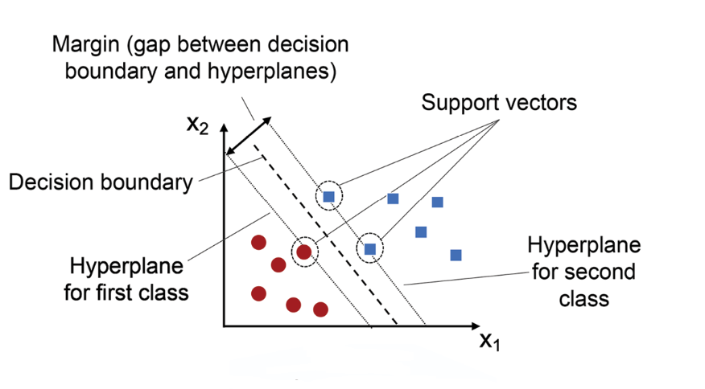
Machine learning Algorithm used cont.
Support Vector Machines
Notes:
Support Vector Machine (SVM): Used to find a hyperplane that best fits the data points in a continuous space to separate the different classes.

Slide 13
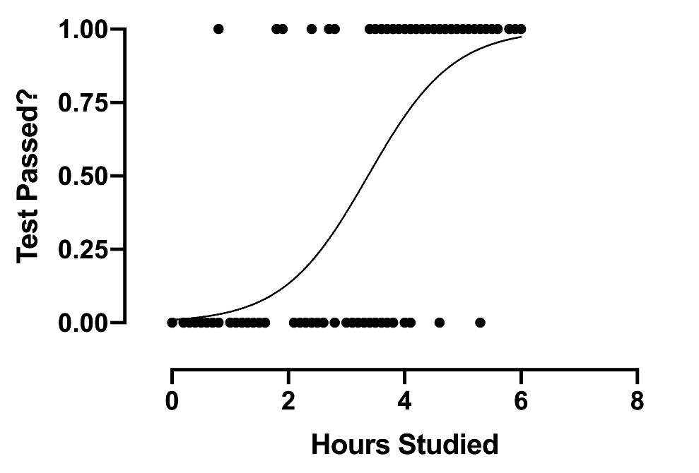
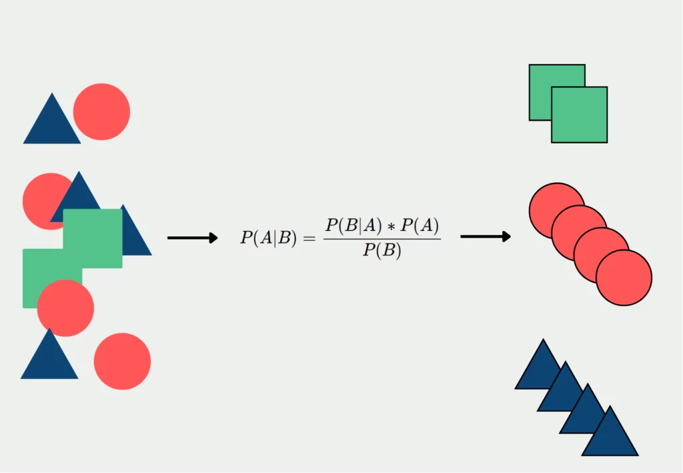
Machine learning Algorithm used cont.
Logistic Regression Algorithm
Multinomial Naive Bayes
Notes:
Logistic Regression is a machine learning algorithm that is used to predict the probability of a categorical outcome
Multinomial Naive Bayes is a probabilistic machine learning algorithm that is used for text classification

Slide 14
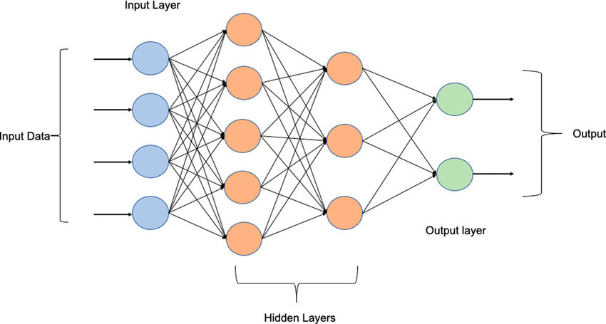
Machine learning Algorithm used cont.
Multi-Layer Perceptron
Notes:
multi-layer perceptron: which is a type of neural network that can be used for logistic regression. A neural network is a machine learning model that is inspired by the way the human brain works. It is made up of interconnected nodes, called neurons, that transmit signals to each other.

Slide 15
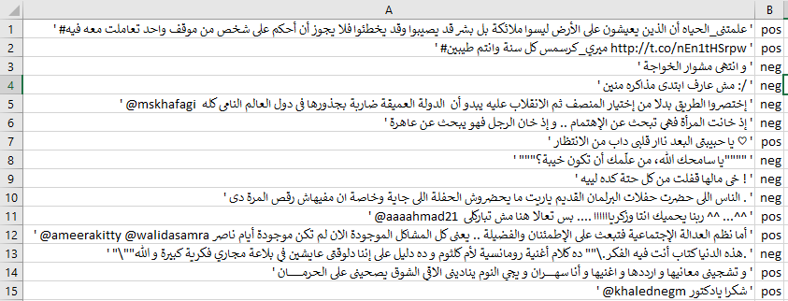
Original Data set
Dataset: https://www.kaggle.com/datasets/kirolosatef/nlparabictweets
The dataset consists of 2059 Arabic tweets with their polarity
Notes:
Download the Dataset from Kaggle
Original dataset consists of 2059 Arabic tweets with their polarity

Slide 16
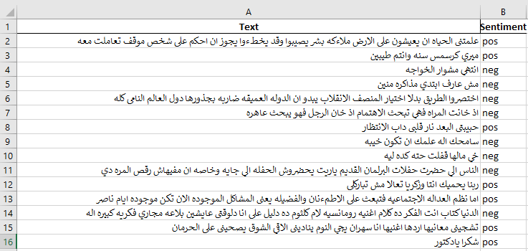
Normalized Data set
Tweet changed from (‘#ميري_كرسمس كل سنة وانتم طيبين http://t.co/nEn1tHSrpw ‘)
To this one (ميري كرسمس سنه وانتم طيبين )
Notes:
remove the tweet tags, emails, URLs, extra spaces, and phone numbers.

Slide 17
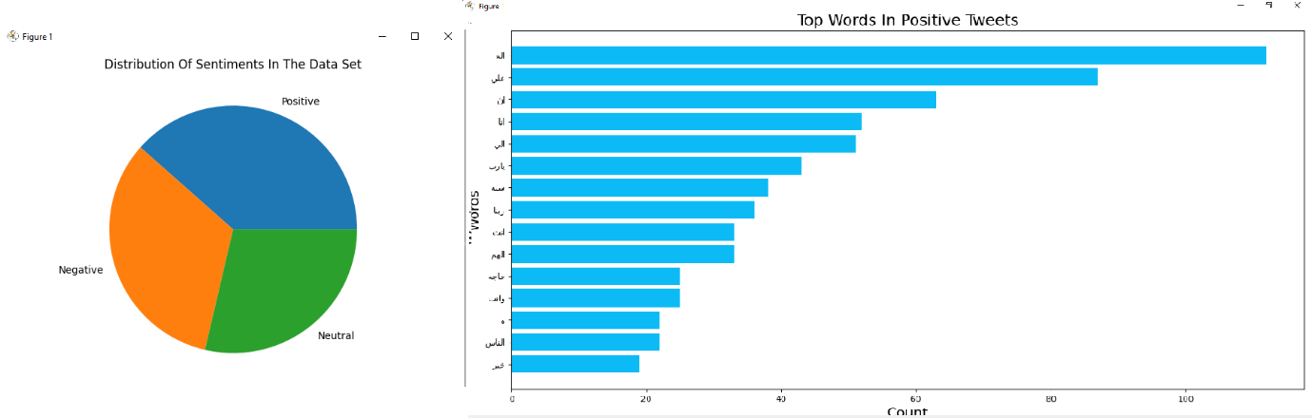
Data Visualization
We can see that all the classes have balanced distribution.

Slide 18
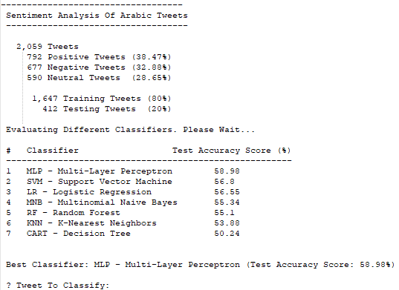
Final Output
MLP is the Best Classifier

Slide 19
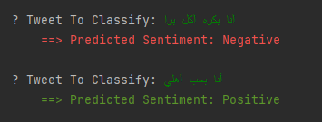
User Tweet Classifying

Slide 20
Conclusion
This research was able to answer the research questions.
Successfully applied machine learning techniques to classify Arabic tweet sentiment within three different groups.
Different ML were used, evaluated and ranked. MLP get the highest accuracy rate of 58.98 %.
The software used the best model (MLP) to predict new Arabic text sentiment.

